Slide 1


The Data Lifecycle
Resource Management Transformation

Slide 2




What is a Lifecycle?
“…the sequence of stages data goes through, from its creation to its eventual disposal, encompassing the entire lifespan of data within an organization or system..”
“…a series of phases over the course its useful life. Each phase is governed by a set of policies that maximizes the data’s value during each stage of the lifecycle”
“The flow of data throughout its life: from creation and initial storage to the time when it becomes obsolete and is deleted.”
“…illustrates how data (in all its various forms and derivatives, including data points, datasets, databases, data files, visualizations, and code) conceptually flows through its lifecycle of usefulness..”
134B3D5
Notes:
The concept of a data lifecycle is that the creation and existence of data is similar (at least in concept) to the creation and existence of an organism. It fulfills a purpose, ages, and eventually dies. As it ages it’s able to accomplish more, take on more responsibilities, and ultimately strengthen the ecosystem.
As data ages it becomes better understood and can play a more active role in supporting other business functions and processes and even support improved decision making.
The reason for discussing a data lifecycle is to understand the movement of data through a company from the point-in-time of data creation to the point-in-time of data usage.

Slide 3
Data Lifecycle Unarguable Concepts about Data
Data supports activities beyond its initial business process or functional role
Data’s value will change over time
May be used to support additional business processes (purchase/warranty/market)
Spawns/generates new data
May decrease in value over time (so we archive it)
Historical detailed data has value
Analytics allows us to review events and quantify impact
Detailed data enables advanced analytics and prediction
Data has a limited lifespan – it is not always a “forever asset”
Details are corrected or changed (recasting history, financial adjustments, etc.)
Data may have an associated liability. Destruction may be necessary
134B3D5
134B3D7

Slide 4
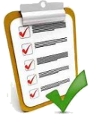




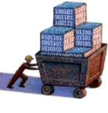
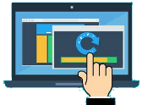



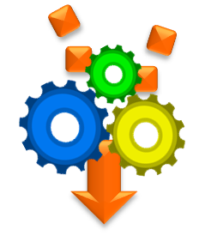


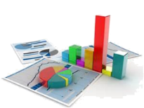








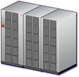

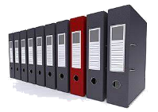











The Stages in a Data Lifecycle
POS
Services
(APIs)
Cloud
Kiosk
Web
Files
Database
validate
Provisioning
Update
Client /
Front Office
Data Center
Retrieve
transform
Analytics
Recast
HR
messages
Data Lake
Acct
Users
Files
streams
standardize
Back Office
Receive
Data Warehouse
Decisions
Archive
Cleanse
Open Data
Research
Vendors
Enhance
Catalog
Insight
External
Data Lake
Purge
Create
Gather
Process
Store
Use
Expire
134B3D5
134B3D7

Slide 5
Data Lifecycle Stage: Create
Most business data content is created within three distinct domains: front office, back office, and external.
Front Office – Customer (or supplier) facing operational applications
Back Office – Management and administrative application systems
External – 3rd party data providers (Open Data, vendors, research, etc.)
Kiosk
POS
Web
Client /
Front Office
HR
Observations
Few applications systems are designed to package/share data. Access typically requires custom code.
The largest growing area of data content is 3rd party data providers and analytics users. Few environments are prepare to support user data publishing and sharing
Acct
Users
Back Office
Open Data
Research
Vendors
External
Create
Considerations
As environments mature, there are often multiple “systems of creation”. Data Catalogs and lineage tracking will emerge as a business requirement.
Creating a supply-driven approach for data access is a best practice. It’s impractical for development teams to manage a growing quantity of sources.
134B3D7

Slide 6
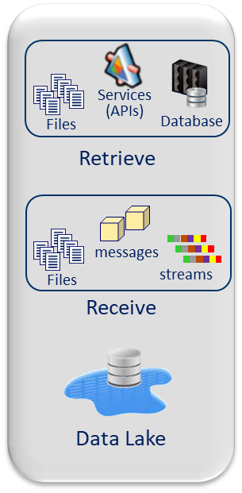
Data Lifecycle Stage: Gather
Most companies have established source data access as a data consumer-based activity. There are two approaches to gathering: retrieve and receive.
Retrieve – The most common approach is bulk data retrieval. There are API (or services) interfaces that support bulk and transactional data retrieval
Receive – A scheduled or on demand mechanism for data delivery. Data may be delivered in bulk or transactionally.
Observations
The most common mechanism is source system generated extract files being deposited in a shared storage environment
Some organizations have positioned a “Data Lake” platform for centralizing source data storage (and simplifying access to source system data)
Considerations
Extracts are often built on a case-by-case basis with little thought regarding reuse and sharing.
Few IT organizations budget application teams to address source data sharing (and extract creation). A demand-driven approach is wasteful and costly.
Gather
134B3D5

Slide 7
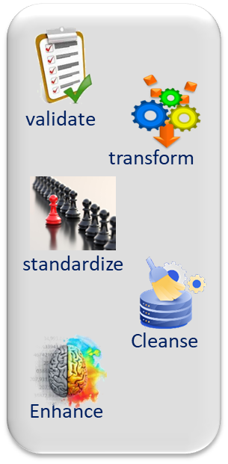
Data Lifecycle Stage: Process
Converting data from its raw form to make it “ready to use”. Some of the most common activities include:
Cleanse – the process of fixing or removing incorrect, corrupt or incomplete data
Transform - converting data from one format to another
Standardize – modifying the representation of data to support processing
Validate – testing data against a set of acceptance rules
Observations
This lifecycle stage occurs with both operational and analytical systems. It’s often referred to as “data transformation”, “ETL”, or “Data Engineering”.
“Data Wrangling” or “Data Preparation” are often used to refer to user-centric data transformation tools.
Considerations
Operational and Analytical systems use different tool sets to address this stage.
Processing is addressed with ETL tools or traditional 3GL languages (Python, C, etc.)
Productivity is often 10x-20x with ETL tools due to source impact analysis, lineage, and greater troubleshooting/debugging capabilities.
Data quality tools can dramatically reduce development and processing times.
Process
134B3D5

Slide 8
Data Lifecycle Stage: Store
Providing data that’s business rationalized data to support provisioning and analysis. This data reflects business terminology, rules, and rigor and supports enterprise and/or department level usage.
While this stage typically support analytics processing, it may also support data delivery to other operational processing platforms.
Cloud
Data Center
Data Mart
Observations
The most common storage environment is SQL-based; however, data maybe stored in a variety of technologies (files, NoSQL, etc.).
Data at this stage reflects business terminology; it should be referenceable within a catalog (metadata repository).
Data Warehouse
Catalog
Considerations
This stage establishes “business-checked” data. Users assume that data has undergone data acceptance and quality processing.
If data reflects a non-enterprise format (e.g. organizational, application, etc.), it is often placed on a functional-specific platform (data mart)
Store
134B3D5

Slide 9
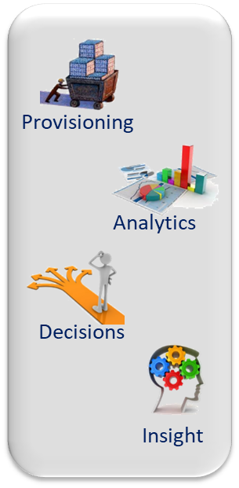
Data Lifecycle Stage: Use
Business-level data usage that enables business processing, analysis, and decision-making. Data Usage is not limited to strategic or historical analytics; it may include operational analytics, functional processing, or data provisioning.
Observations
“Analytics” is a very broad domain and includes variety of analysis and data visualization techniques.
AI/ML is likely the hottest segment within data usage; it hasn’t diminished the interest or popularity in any other aspect of data usage.
Considerations
The biggest obstacle in data usage is data management support. Data usage isn’t feasible if data can’t be found, accessed, and prepared.
As analytics has matured, the importance of privacy, security, usage tracking, and usage ethics has become highly visible
Use
134B3D5

Slide 10
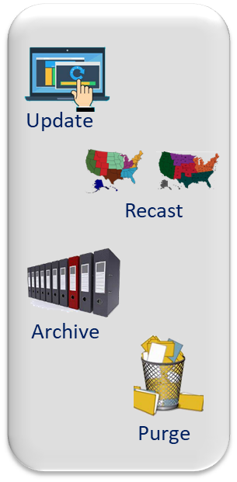
Data Lifecycle Stage: Expire
Data’s usefulness is no longer viable. Some of the reasons that data is archived and/or deleted may include
Obsolescence – the data is no longer usable or valuable
Risk Mitigation – keeping unnecessary data generates unacceptable liability or risk
Data Quality/Accuracy – the data has been replaced with more accurate details
Observations
Archiving systems is a common practice for operational platforms (the retention period is often forever). Analytics systems is often 7-15 years (depending on industry).
The costs of purging and archival are receiving renewed interest due to the popularity of cloud migration the ongoing cost of data storage.
Considerations
Many organization’s data retention policy doesn’t align with modern business and analytics needs. While most have policies, few monitor adherence.
The cost of data archival can be substantial, and few organizations provide visibility to this cost.
Expire
134B3D5

Slide 11
Data Management in a Data Lifecycle
Data Standards
POS
Services
(APIs)
Cloud
Kiosk
Web
Files
Database
validate
Provisioning
Update
Client /
Front Office
Data Center
Retrieve
Data Governance
transform
Analytics
Recast
HR
messages
Data Lake
Users
streams
standardize
Data Access
Acct
Files
Back Office
Receive
Data Warehouse
Decisions
Archive
Cleanse
Data Security
Open Data
Research
Vendors
Enhance
Catalog
Insight
External
Data Lake
Purge
Create
Gather
Process
Store
Use
Expire
134B3D5
134B3D7

Slide 12
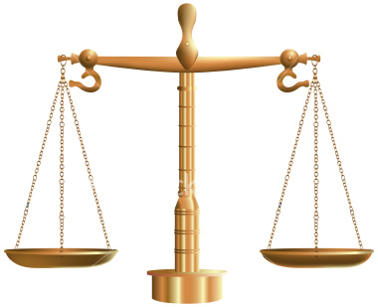
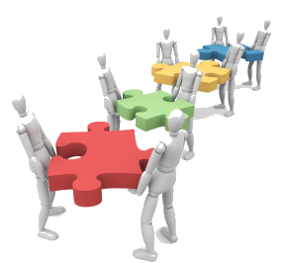
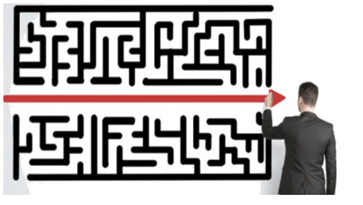

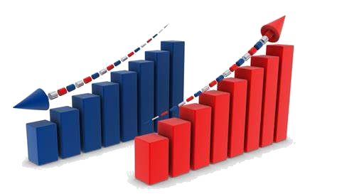

Why a Data Lifecycle Matters to RMT (and OCFO and DHS)
Stages are separate but related
Data acceptance and accuracy crosses stages
Access will include Raw and Cooked data
Value and impact may not be immediate
New data can increase or diminish CFOH value
Data changes affect downstream consumers
134B3D7

Slide 13

Thank You!

